Slide 1
Operating system security Antiviruses

Slide 2
What is Operating System Security?
The process of ensuring OS availability, confidentiality, integrity is known as operating system security. OS security refers to the processes or measures taken to protect the operating system from dangers, including viruses, worms, malware, and remote hacker intrusions. Operating system security comprises all preventive-control procedures that protect any system assets that could be stolen, modified, or deleted if OS security is breached.
Security refers to providing safety for computer system resources like software, CPU, memory, disks, etc. It can protect against all threats, including viruses and unauthorized access. It can be enforced by assuring the operating system's integrity, confidentiality, and availability. If an illegal user runs a computer application, the computer or data stored may be seriously damaged.

Slide 3
What is Antivirus software and how it works?
A virus scanner is essentially software that tries to prevent a virus from infecting your system. In general, virus scanners work in two ways. The first method is that they contain a list of all known virus definitions. The virus definitions are simply files that list known viruses, their file size, properties, and behavior. Generally, one of the services that vendors of virus scanners provide is a periodic update of this file. This list is typically in a small file, often called a .dat file (short for data). When you update your virus definitions, what actually occurs is that your current file is replaced by the more recent one on the vendor’s website.
The antivirus program can then scan your PC, network, and incoming email for known virus files. Any file on your PC or attached to an email is compared to the virus definition file to see whether there are matches. With emails, this can be done by looking for specific subject lines and content. The virus definitions often also include details on the file, file size, and more. This provides a complete signature of the virus.
The second way a virus scanner can work is to look for virus-like behavior. Essentially, the scanner is looking to see if the file in question is doing things that viruses typically do—things like manipulating the Registry or looking through your address book.

Slide 4
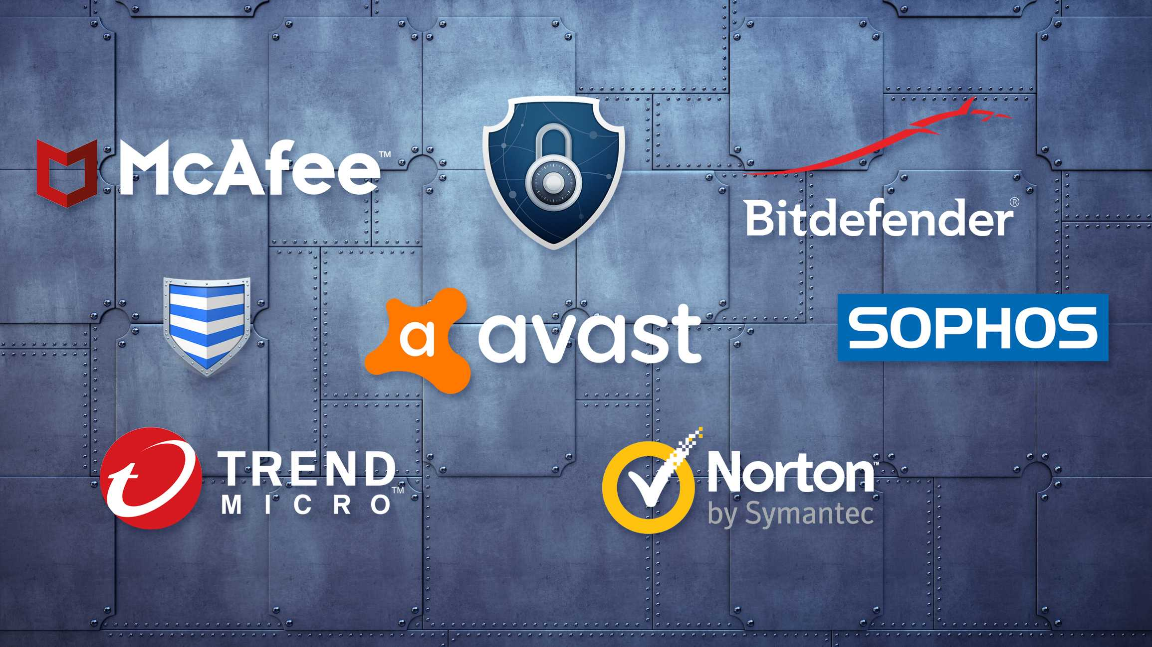

Slide 5
Types of antivirus programs
Windows antivirus software. Most antivirus software vendors offer several levels of Windows products at different price points, starting with free versions offering only basic protection. Users must start scans and updates manually and typically free versions of antivirus software won't protect against links to malicious websites or malicious attachments in emails. Premium versions of antivirus software often include suites of endpoint security tools that may provide secure online storage, ad blockers and file encryption. Since 2004, Microsoft has been offering some kind of free antivirus software as part of the Windows operating system itself, generally under the name Windows Defender, though the software was mostly limited to detecting spyware prior to 2006.
macOS antivirus software. Although macOS viruses exist, they're less common than Windows viruses, so antivirus products for macOS are less standardized than those for Windows. There are a number of free and paid products available, providing on-demand tools to protect against potential malware threats through full-system malware scans and the ability to sift through specific email threads, attachments and various web activities.

Slide 6
REFERENCES
https://www.javatpoint.com/operating-system-security
https://www.techtarget.com/searchsecurity/definition/antivirus-software

